Slide 1
Carbon Footprint Intelligence System for Coal Mines
ZeroPoint8
Problem Statement Title- A web application specifically designed for Indian coal mines to quantify their carbon footprint and explore pathways to carbon neutrality.
Theme- Renewable/ Sustainable Energy
Members:- 12211148 Palash Bhivgade 12210462 Pratham Bisen

Slide 2
PROBLEM STATEMENT
ZeroPoint8
India's coal mining sector faces the challenge of balancing energy needs with climate commitments.
To achieve carbon neutrality, mines must reduce emissions from activities like excavation and transportation, adopt cleaner technologies, and offset remaining emissions through afforestation.
This web-based application aims to quantify carbon emissions, estimate carbon sinks, and suggest pathways to neutrality through strategies like renewable energy use and carbon credits.
The app will provide data visualization, support decision-making, and accommodate different mine sizes to promote sustainability in India's coal sector.

Slide 3



Carbon Sathi
ZeroPoint8
Proposed Solution (Describe your Idea/Solution/Prototype)
How it Addresses
How it Addresses
Transparency in Emissions
AI Driven Decision Making
Cost Saving & Efficiency
Integration with renewable Energy
Committing to National Climate Goals
Innovative Approach
Innovative Approach
Custom Emission Factors
Real-Time Emissions Monitoring
Carbon Credit Calculation
Government & Industry Collaboration
Planning Carbon offset Projects
ESG Regulatory Report Generation
Proposed Solution
Proposed Solution
Activity –wise Emission Quantification
Existing Carbon Sinks & Gap Analysis
Customizable Neutrality Pathway
Regulatory Compliance
Scalability (Variations in Mines)
Per Capita Emissions
Visualization
Notes:
© Copyright PresentationGO.com – The free PowerPoint template library

Slide 4
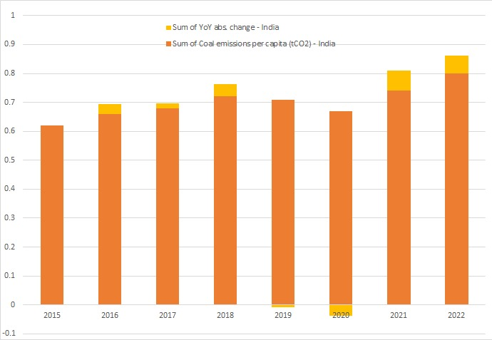
IMPACT AND BENEFITS
ZeroPoint8
Diagram below shows Increase in per capita emissions
IMPACT –
Mining Companies:
Enables emission tracking and reduction, enhancing sustainability and regulatory compliance.
Government Bodies:
Offers a transparent method for monitoring and enforcing environmental policies in coal mining.
Local Communities:
Improves air quality and health by promoting carbon neutrality near mining areas.

Slide 5
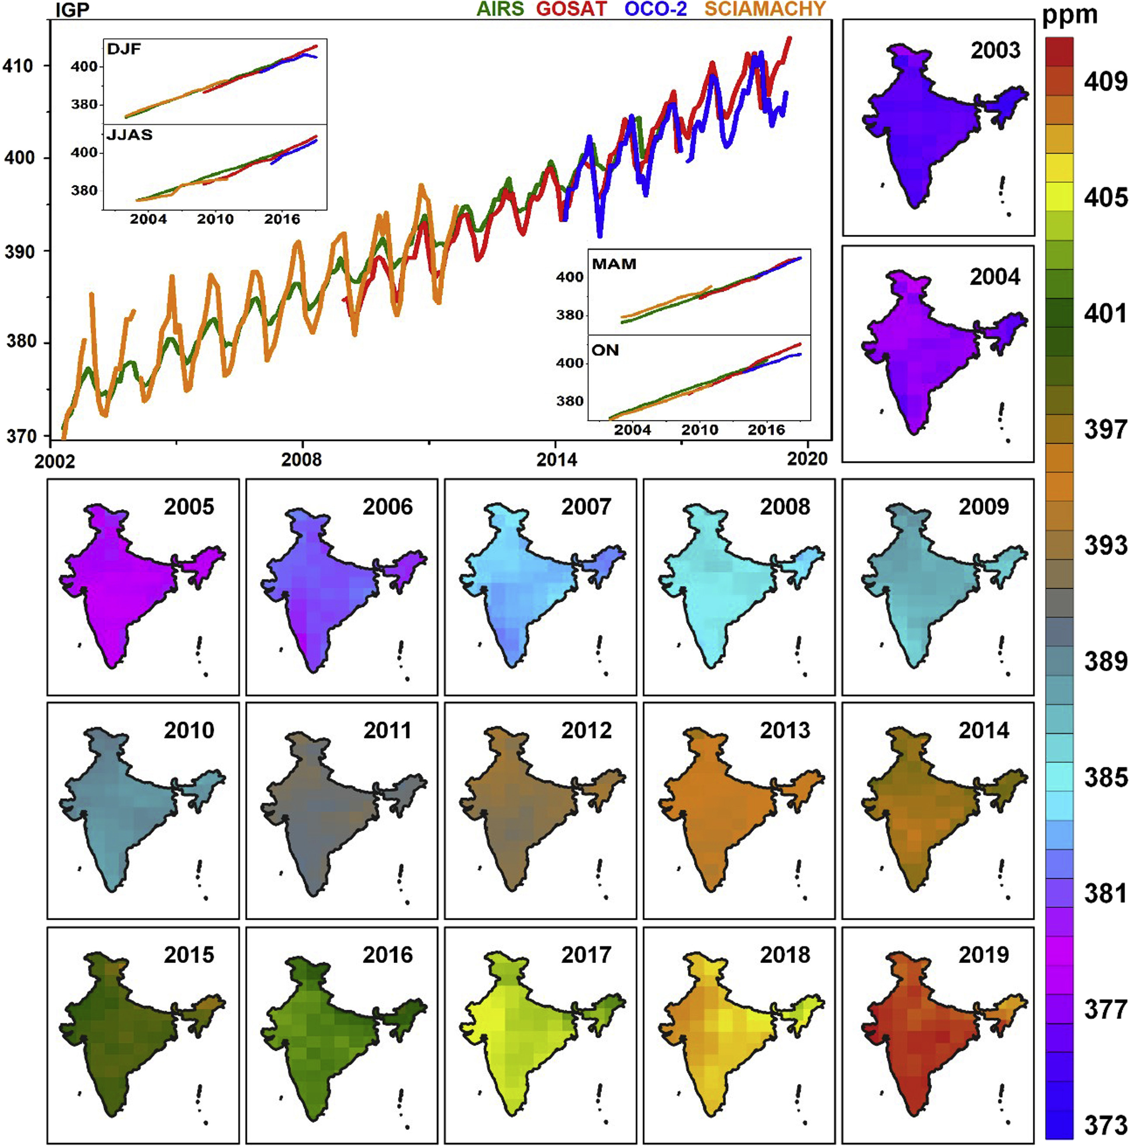
IMPACT AND BENEFITS
ZeroPoint8
Diagram shows Increase in carbon presence in Indian atmosphere, which proves decrease in carbon neutrality over the years.
BENEFITS –
Social:
Encourages responsible mining, improving living conditions and raising environmental awareness.
Economic:
Optimizes operations, reduces costs, and creates revenue through carbon credits.
Environmental:
Lowers emissions, promotes cleaner technologies, and supports India's climate goals.

Slide 6
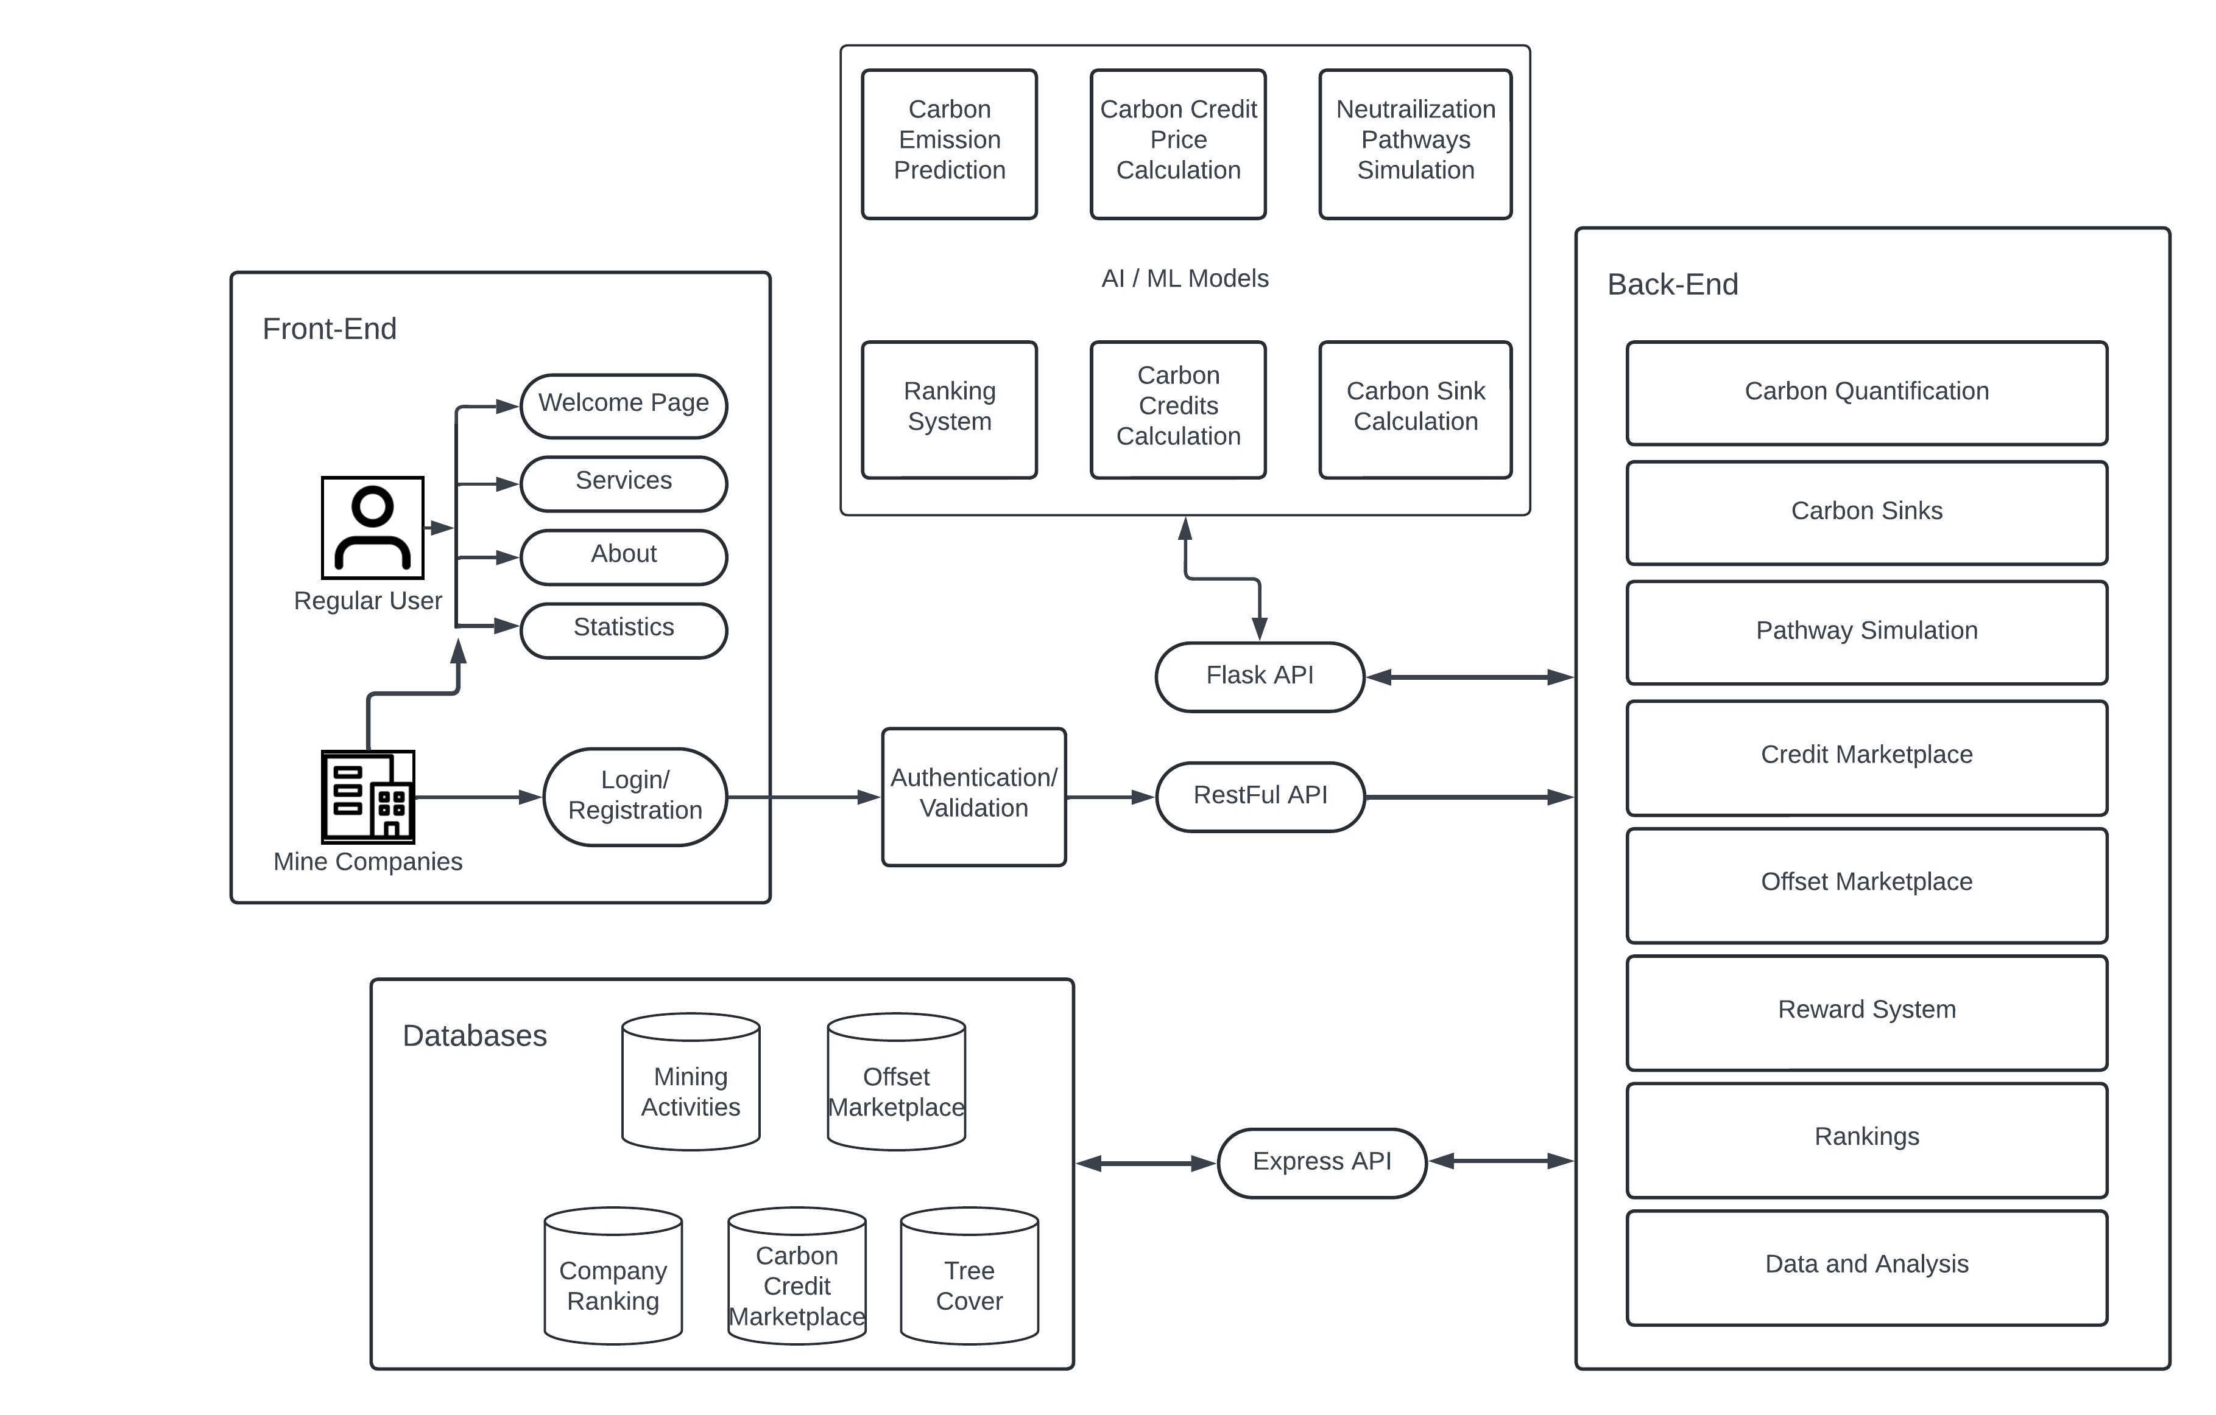
Solution Diagram
ZeroPoint8

Slide 7
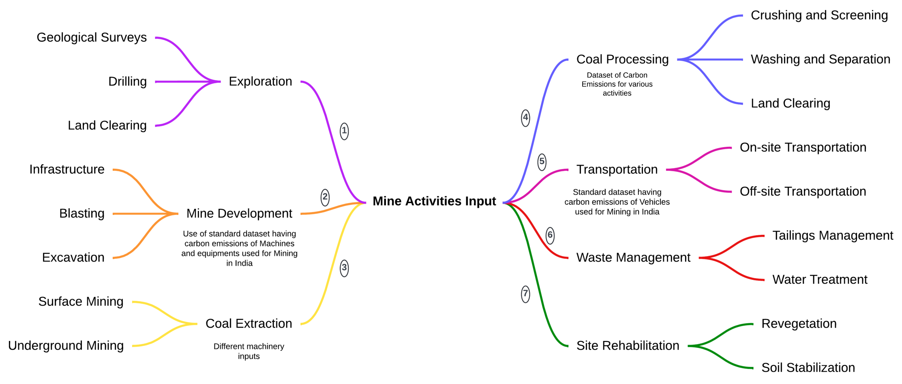
FEASIBILITY AND VIABILITY
ZeroPoint8
The diagram below visually represents this process, highlighting the key steps involved in input collection and how it contributes to the feasibility and effectiveness of our application.

Slide 8
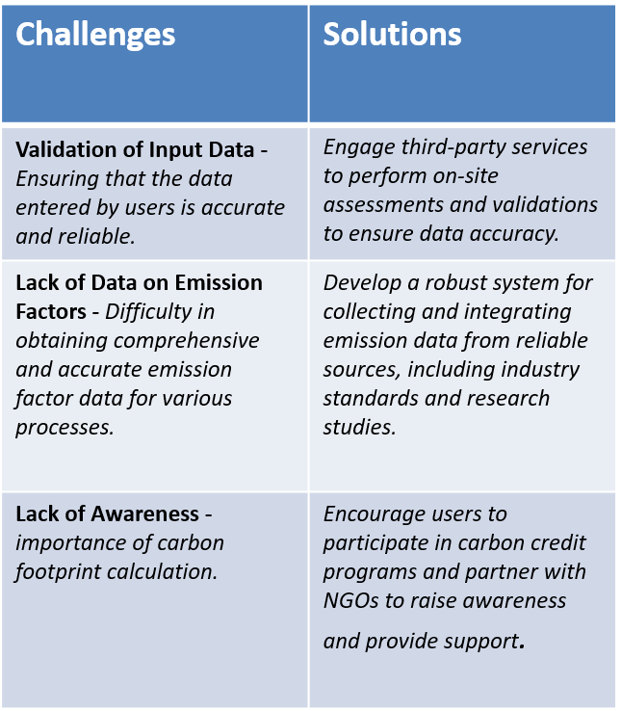
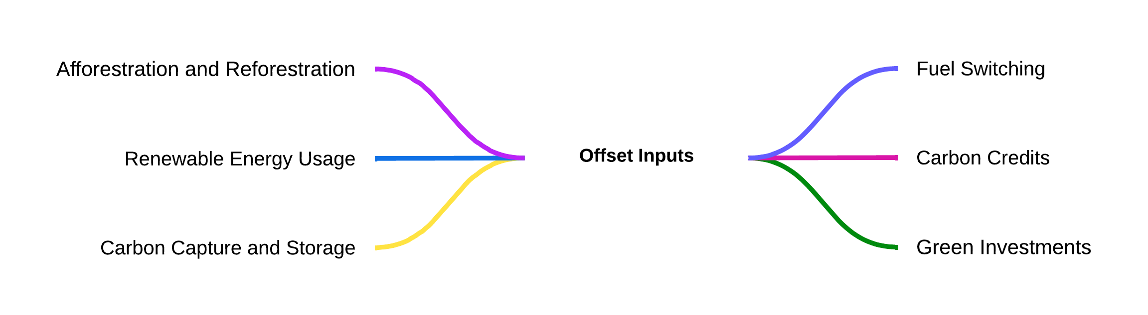
FEASIBILITY AND VIABILITY
ZeroPoint8
Potential Challenges & Solutions

Slide 9
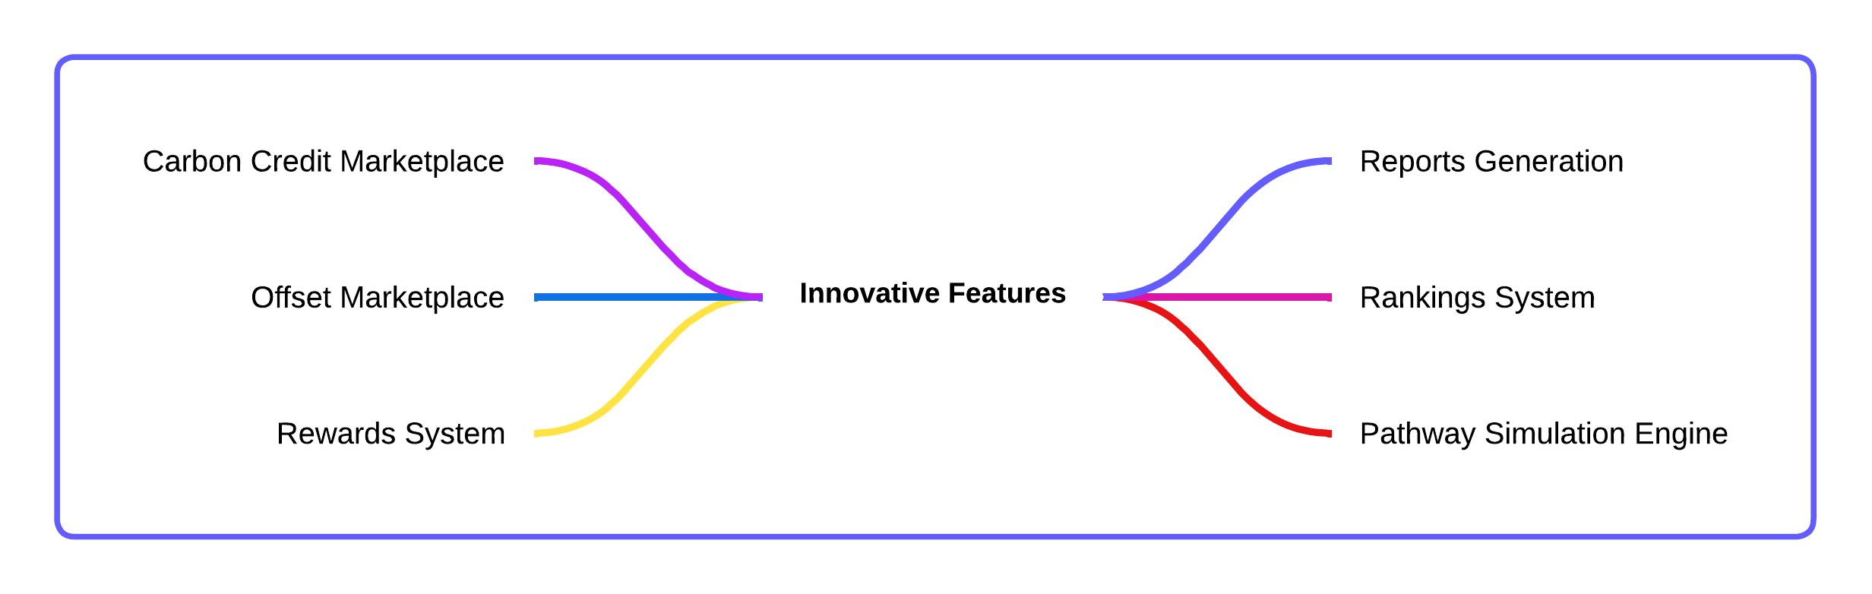
Innovative Features
ZeroPoint8

Slide 10
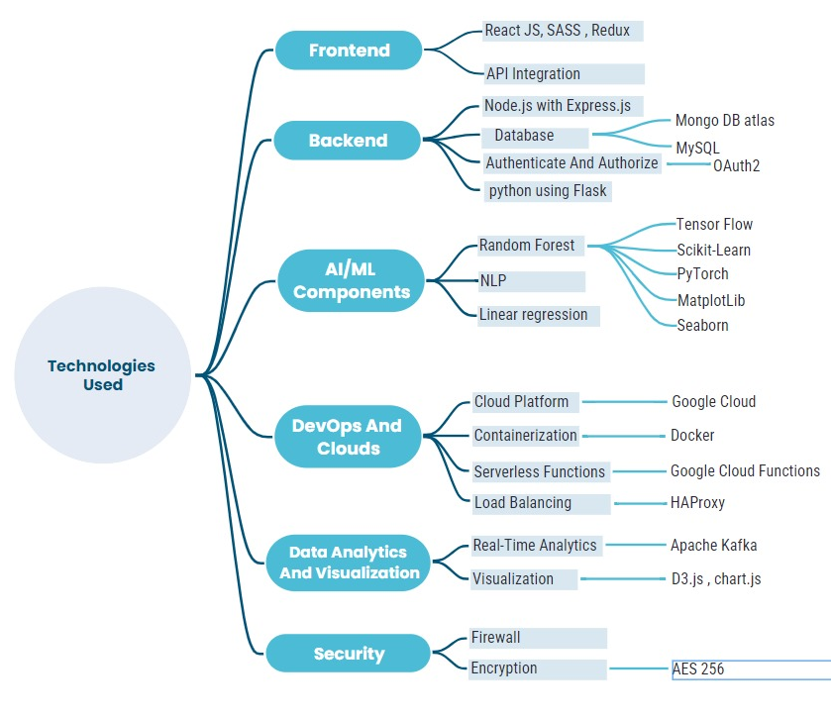
TECHNICAL APPROACH
ZeroPoint8
Technologies to be used

Slide 11
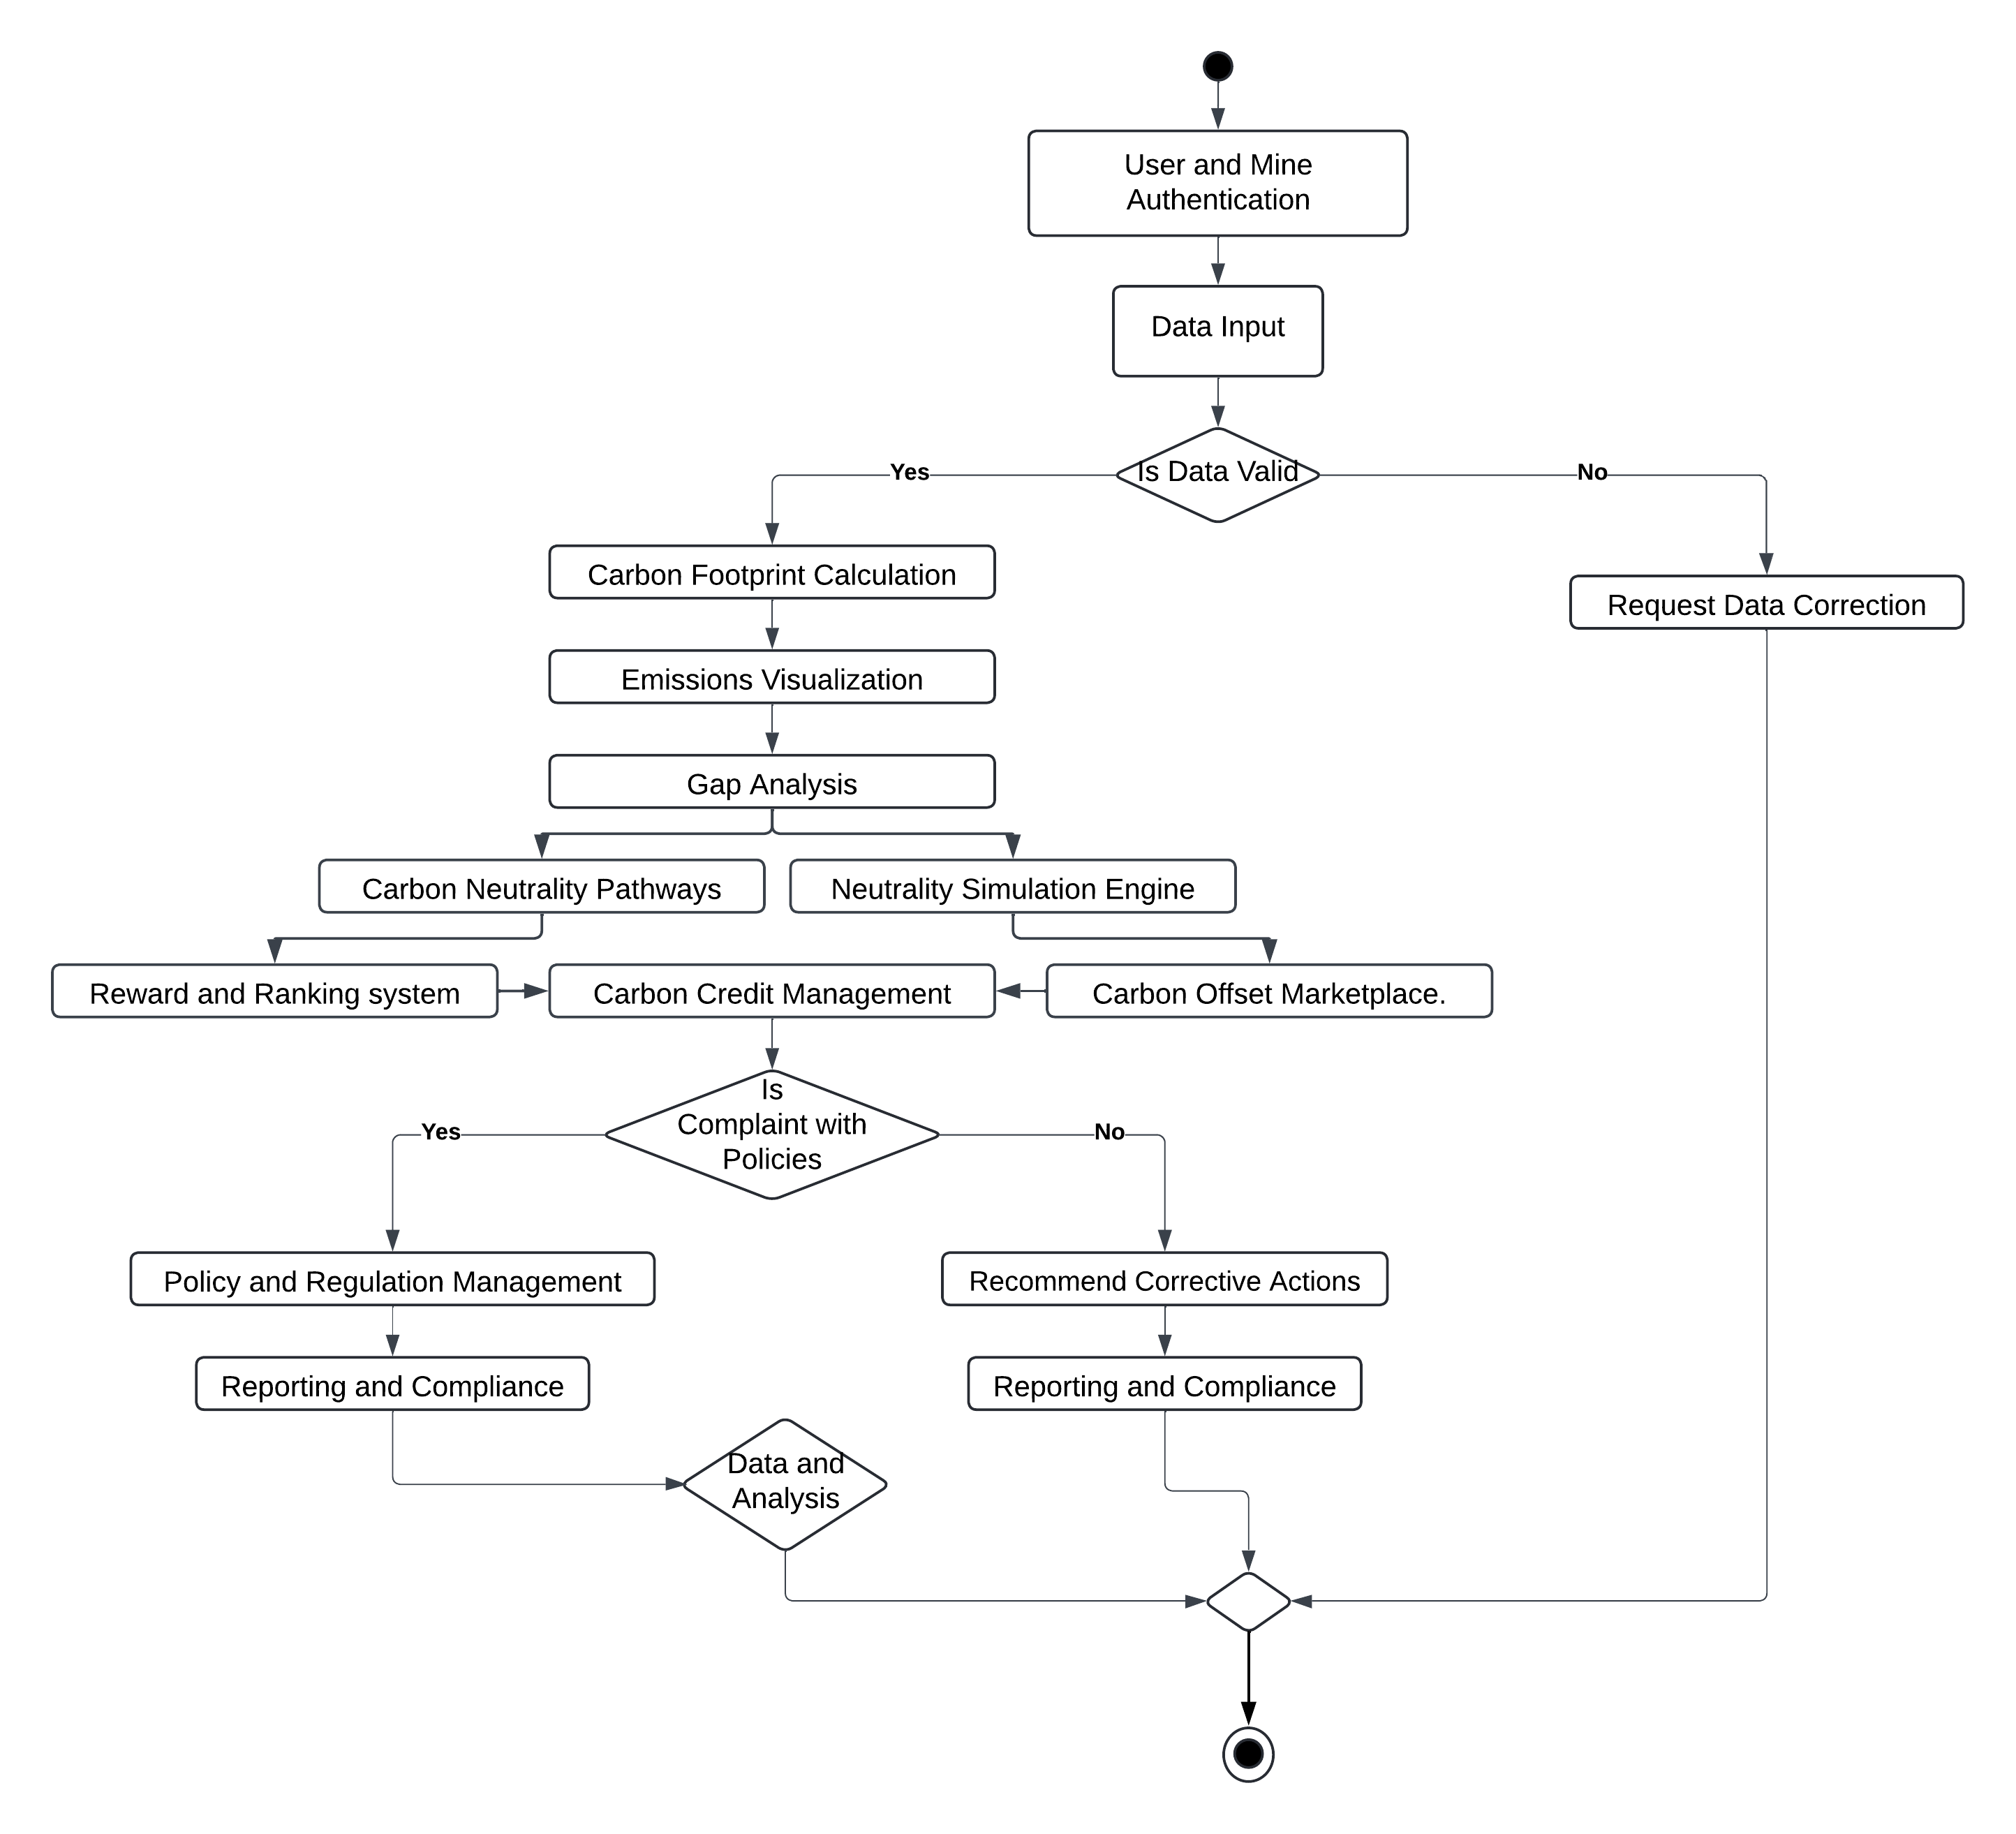
ZeroPoint8
Methodology (Flowchart)

Slide 12
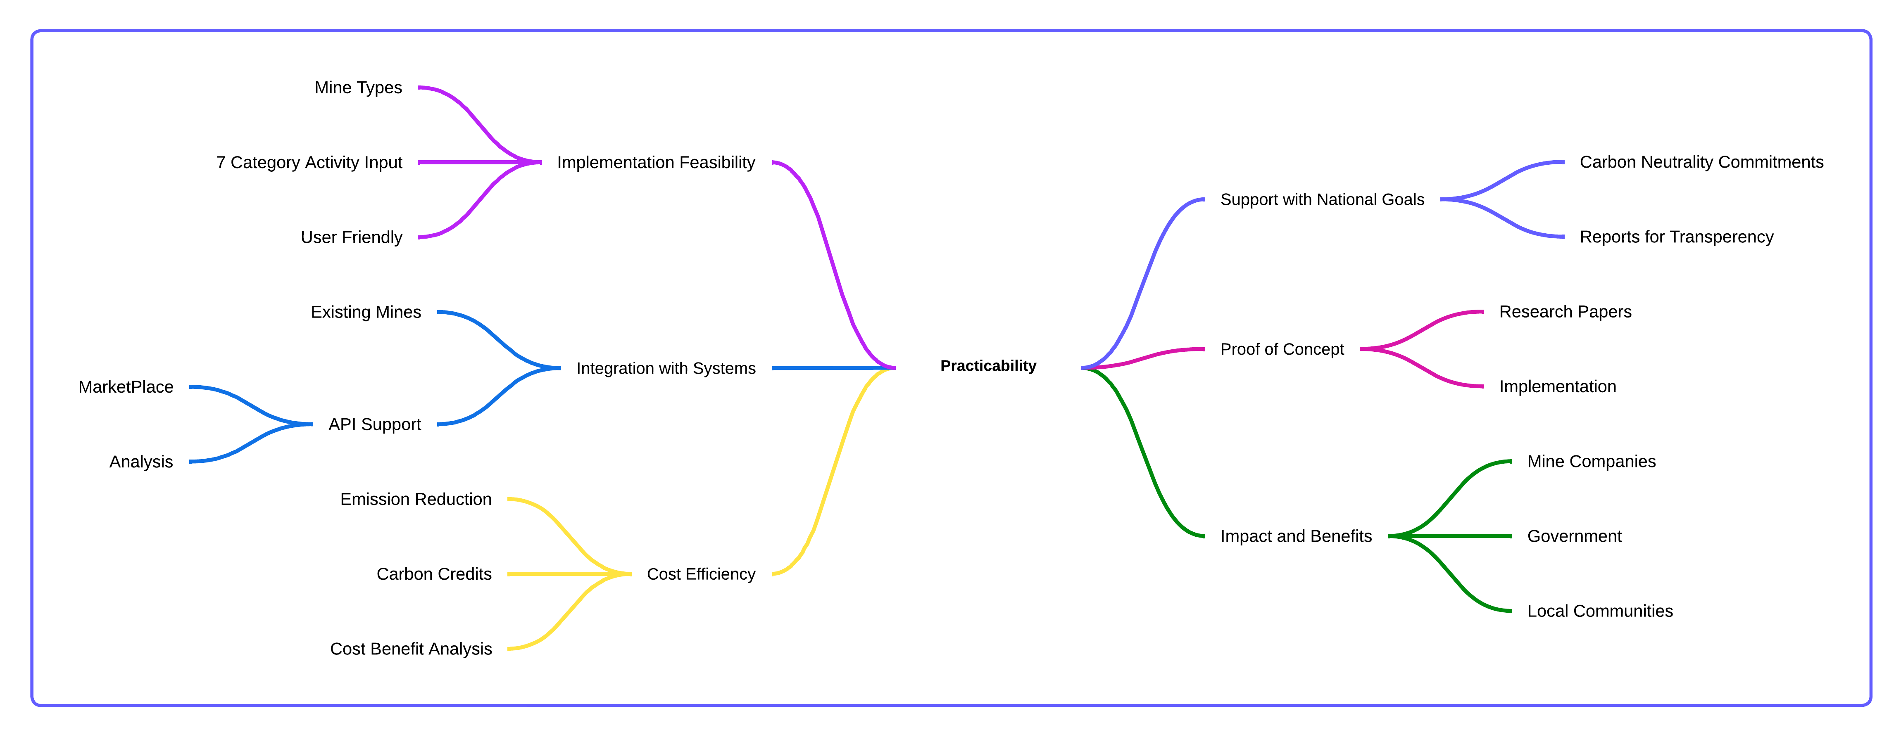
Practicality
ZeroPoint8

Slide 13
RESEARCH AND REFERENCES
ZeroPoint8
Blogs:
GHG Institute. (2022, October 31). What are emission factors & How to find them? Retrieved from GHG Institute
World Bank. (2023, August 1). It’s critical to tackle coal emissions. Retrieved from World Bank Blog
Carbon Credit Capital. Blog. Retrieved from Carbon Credit Capital Blog
The Coal Hub. Blog. Retrieved from The Coal Hub Blog
ScienceDirect. (2022, December 15). Title of the Article. Retrieved from ScienceDirect.
Research Papers:
1.Carbon Footprints of Construction Industries: A Global, Supply Chain-linked Analysis: IEEE-2018
2. Standard Measurement of Carbon Footprints: IEEE-2016
3. Introduction to Climate Change & Carbon Foot printing: IEEE-2021
4. Reducing Carbon Footprint with a Knowledge-Based Smart Graphing Application: IEEE- 2021
5. Study of Carbon Footprint in an Educational Institution in India: IEEE-2020

Slide 14
THANKYOU !!

